Slide 1

Slide 1
BANK MARKETING DATA
BUAN 6340.001- Group 1.7
Final Presentation
Group Members
Lavanya Kolhapur
Suhas Patil
Shrisha Vanga
Oshin Chetule

Slide 2
DATA SCOPE
Number of Observations : 41188
Missing cells : 0
Variables Distribution
Why?
To effectively group potential investors for future campaign targets
To reduce the cost of marketing campaigns
What?
One of the leading Portuguese Banking Institution trying to increase the subscription of their bank term deposits
- The marketing campaigns were based on phone calls. So this dataset has details of all the calls that were made in the previous marketing campaign
Aim
To predict if a customer will subscribe to a bank term deposit or not
Produce the best model for prediction
BUAN 6340.001
Group 1.7
2

Slide 3
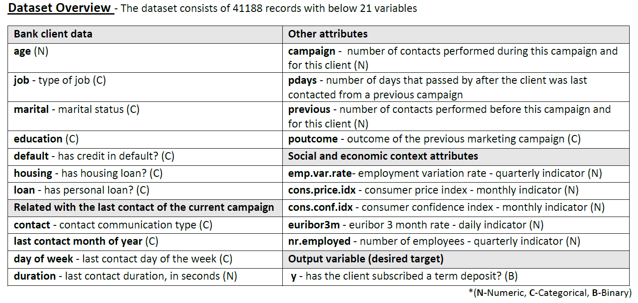
BUAN 6340.001
Group 1.7
3

Slide 4
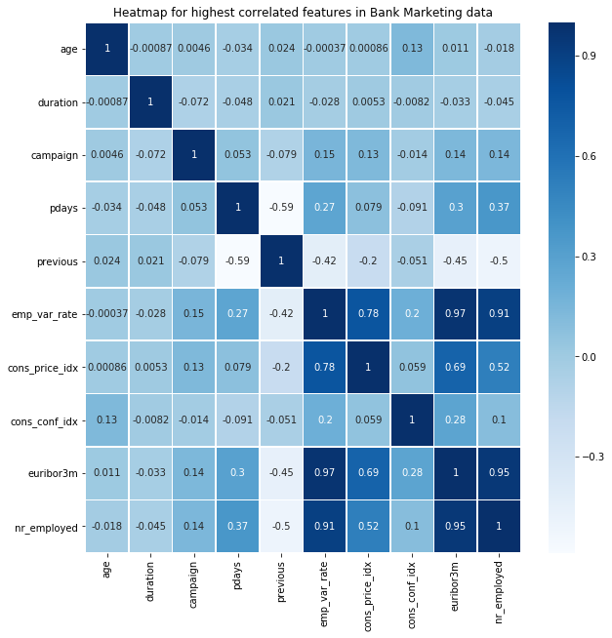
Slide 3
DATA MANIPULATION
e
Pearson’s Correlation Matrix
ρ
0.9722
ρ
0.9451
CORRELATION
CORRELATION
euribor3m is highly correlated with emp-var-rate
nr_employed is highly correlated with euribor3m
0
86.3%
<0.1%
ZEROS
DUPLICATES
previous has 35563 zero records (not null)
Dataset has 12 duplicate rows
BUAN 6340.001
Group 1.7
4

Slide 5

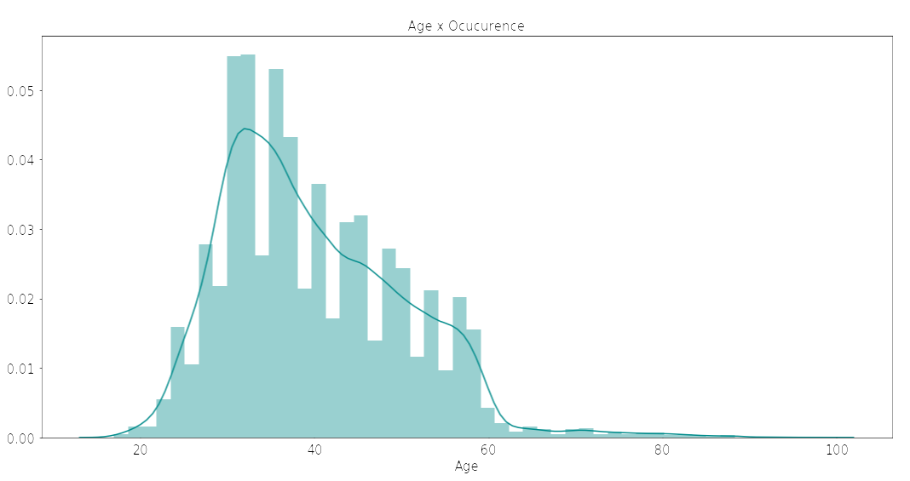
EXPLORATORY DATA ANALYSIS
Y – has client subscribed to a term deposit?
The data set is highly imbalanced. There are 6 times as many ‘No’ cases than ‘Yes’ cases. Therefore, accuracy alone as the evaluation metric won’t cut it. Since False Positives and False Negatives both cost out marketing campaign to a certain degree, we will consider F1 – Score to be our primary evaluation metric.
AGE
Adjacent distribution shows clients in the age range 30-50Yrs forms a major portion and can be targeted clients for further analysis
BUAN 6340.001
Group 1.7
5

Slide 6
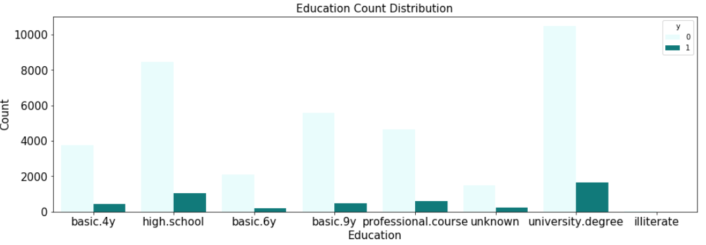
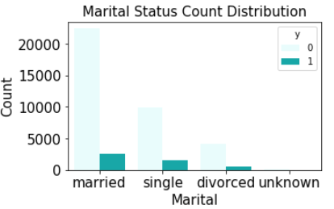
Slide 4
DEMOGRAPHIC VARIABLES
MARITAL
STATUS
EDUCATION
Most of the clients are Married and can be targeted for the next marketing campaign
Clients with University Degree and High School graduated comprises majority of clients if targeted by their education
BUAN 6340.001
Group 1.7
6

Slide 7
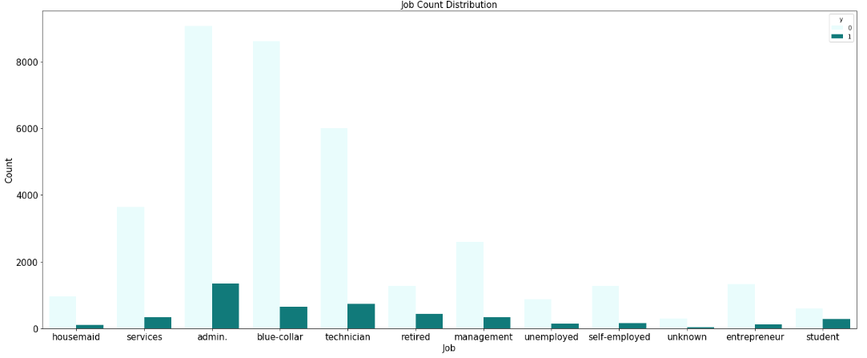
Slide 4
DEMOGRAPHIC VARIABLES
OCCUPATION
People into Administrative jobs are highest clients among all other occupations
BUAN 6340.001
Group 1.7
7

Slide 8


Slide 5
PAYMENT HISTORY
DEFAULT
HOUSING LOAN
PERSONAL LOAN
Most of the clients are not defaulted to previous payments but still they did not agree to open term deposit in last campaign
There is no much difference in the percentage of clients with or without any housing loan
Majority of the clients do not have any Personal loan so they can be targeted as they maintain a good history
69%
45%
82%
BUAN 6340.001
Group 1.7
8

Slide 9


CONTACT INFORMATION
e
CONTACT HISTORY
Elapsed number of days last contacted | Count of Clients
Not contacted (>999 Days) | 39649
0 to 10 Days | 1311
11 to 20 Days | 196
21 to 27 Days | 8
CELLULAR
36.52%
This shows that more than 96% of people were not contacted from the previous campaign, so we need a follow-up with these clients to get their status and update them about the current scheme
TELEPHONE
63.48%
BUAN 6340.001
Group 1.7
9

Slide 10
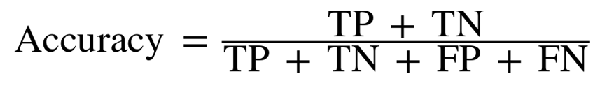
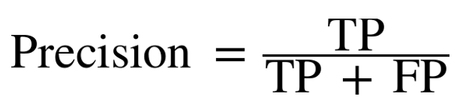

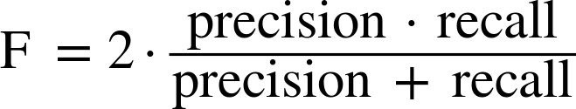
PRECISION & RECALL
Subscribed Term Deposit
Yes
No
Yes
TRUE POSITIVE
FALSE POSITIVE
Predicted Subscription
No
FALSE NEGATIVE
TRUE NEGATIVE
BUAN 6340.001
Group 1.7
10

Slide 11
CLASSIFICATION MODELS
e
CLASSIFICATION MODELS
Dummy Classifier – Base line model
Logistic Regression
K-Neighbors Classifier
Decision Tree
Linear SVC
Kernel SVC
Random Forest
In our project, we are using the mentioned models in order to analyze and make a judgement of which is the best model that predicts the term deposit ‘y’ effectively.
Accuracy score will always be high, even for a dummy classifier which classifies all Y as 0 (High True Negative).
We look at the confusion matrix and compare the models based on F1 score, Recall & Precision.
We also check the model’s performance at various decision function/ probability cut off points using ROC & AUC.
BUAN 6340.001
Group 1.7
11

Slide 12
MODEL BUILDING STEPS
Data Cleaning Missing, Infinite, NaN, symbols etc.
Data Transformation Label encoding & one Hot encoding
Data Sampling and Splitting Random Sample (30%), Test Train Split(3:1)
Data Scaling Min Max or Standard Scaler
Dimensionality Reduction Principal Component Analysis (95% variance)
Grid Search and Cross Validation
Models & Parameter Selection
Build Model With Best Parameters on Train Dataset
Evaluate Performance on Test Dataset
Confusion Matrix, ROC
Compare Models based on Evaluation Metric
F1 Score, Recall, Precision, AUC
Build Ensemble Model
Voting Classifier
BUAN 6340.001
Group 1.7
12

Slide 13
DUMMY CLASSIFIER
Base comparison model
Strategy : Most Frequent
Confusion Matrix: [ 0, 347]
[ 0, 2741]
Accuracy = 88.45%
But True Positives = 0, implies all clients have not subscribed
BUAN 6340.001
Group 1.7
13

Slide 14
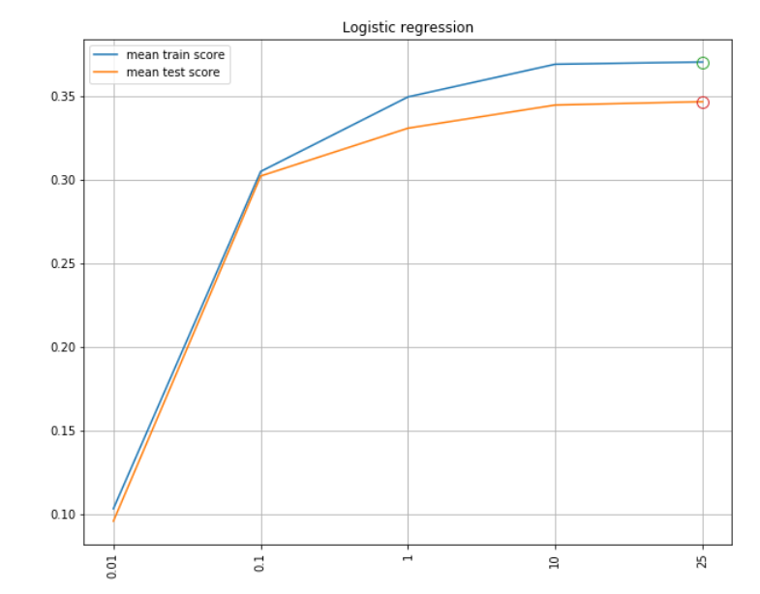
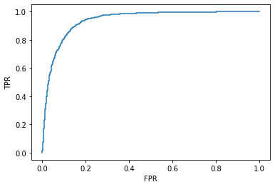
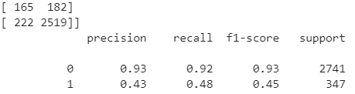
LOGISTIC REGRESSION
Grid Search Parameters
C : 0.01, 0.1, 1, 10, 25
solver: lbfgs, liblinear, saga
Parameter(Optimum): C= 25, Solver= lbfgs
Confusion Matrix [ 85 262]
[ 47 2694
ROC
BUAN 6340.001
Group 1.7
14

Slide 15
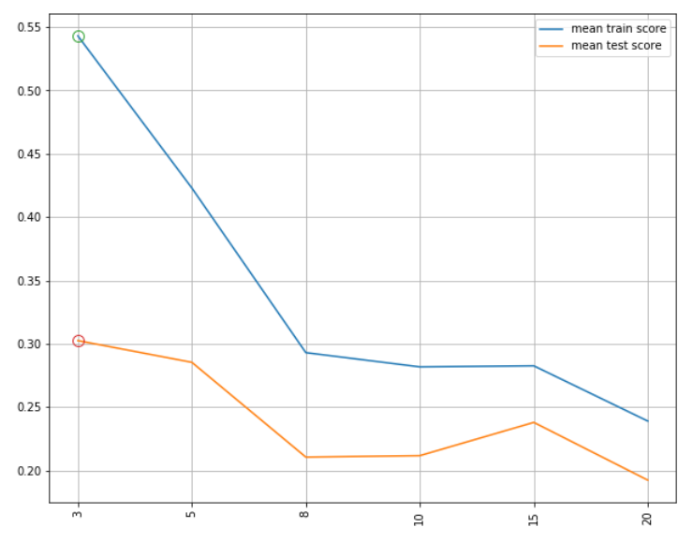
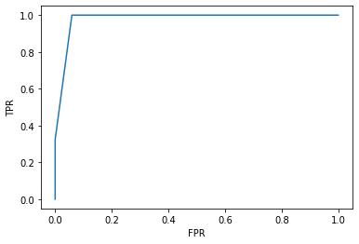
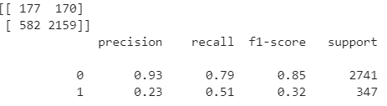
K-NEIGHBORS CLASSIFIER
Grid Search Parameters
n_neighbors: 3, 5, 8, 10, 15, 20
Parameter(Optimum): n_neighbors= 3
Confusion Matrix [ 77 270]
[ 111 2630]
ROC
BUAN 6340.001
Group 1.7
15

Slide 16
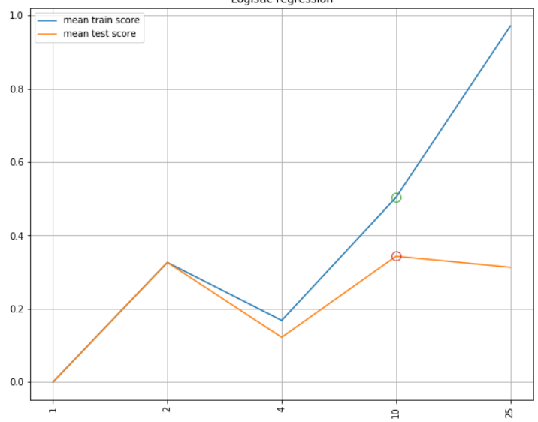
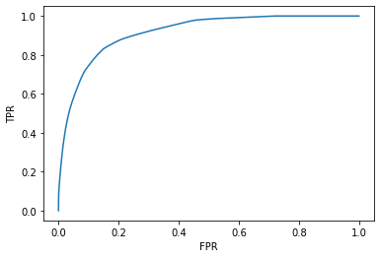
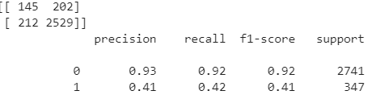
DECISION TREE
Grid Search Parameters
max_depth: 1, 2, 4, 10, 25,
criterion: gini, entropy,
max_features': auto, log2
Parameter(Optimum): criterion= gini, max_depth= 10, max_features= log2
Confusion Matrix [ 94 253]
[ 85 2656]
ROC
BUAN 6340.001
Group 1.7
16

Slide 17
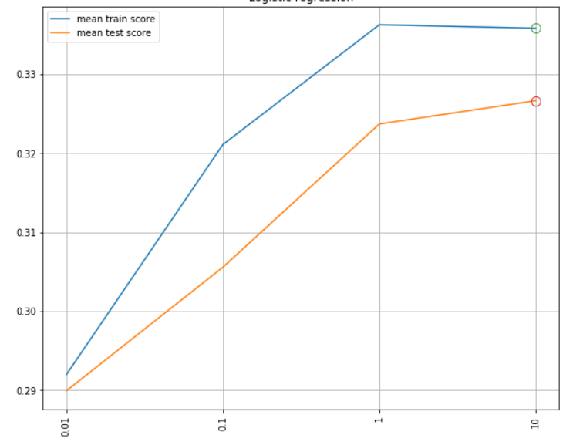
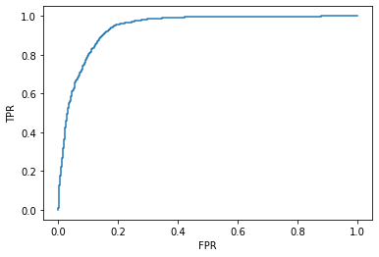
LINEAR SVC
Grid Search Parameters
C: 0.01, 0.1, 1, 10
Parameter(Optimum): C = 10
Confusion Matrix [ 73 274]
[ 36 2705]
ROC
BUAN 6340.001
Group 1.7
17

Slide 18
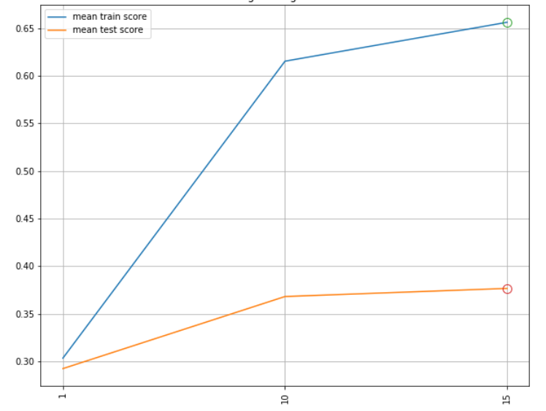

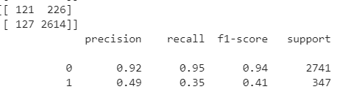
KERNEL SVC
Grid Search Parameters
C: 1, 10, 15,
gamma: 0.01, 0.1, 1
Parameter(Optimum): C= 15, gamma= 0.1
Confusion Matrix [ 100 247]
[ 96 2645]
ROC
BUAN 6340.001
Group 1.7
18

Slide 19
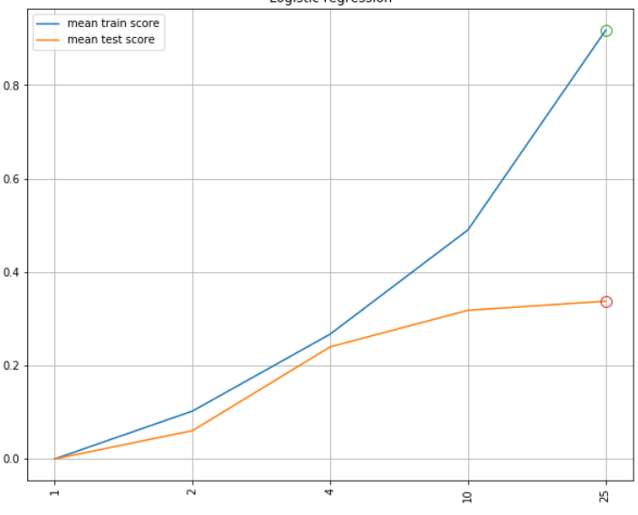
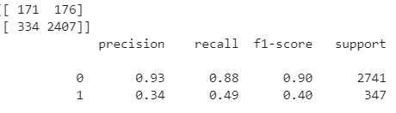
RANDOM FOREST
Grid Search Parameters
max_depth: 1, 2, 4, 10, 25,
criterion: gini, entropy,
max_features': auto, log2
Parameter(Optimum): criterion= entropy, max_depth= 25, max_features= log2
Confusion Matrix [ 94 253]
[ 85 2656]
ROC
BUAN 6340.001
Group 1.7
19

Slide 20
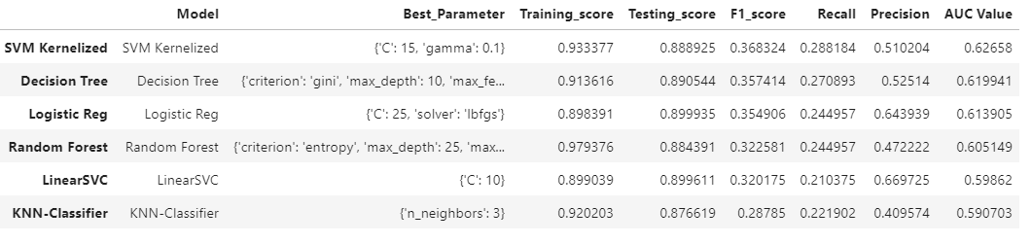
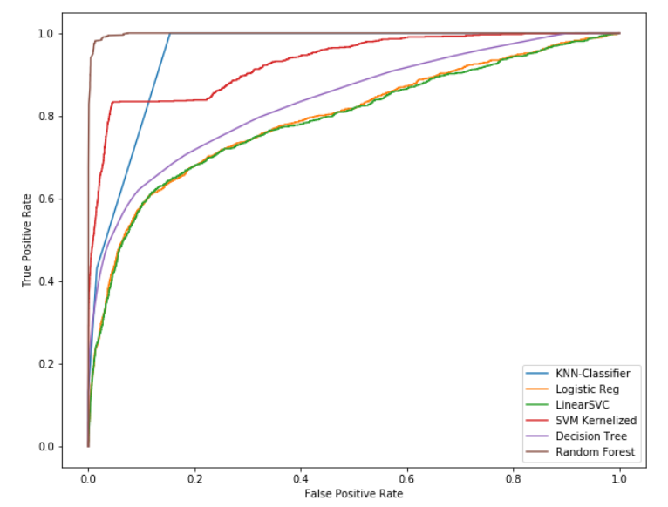
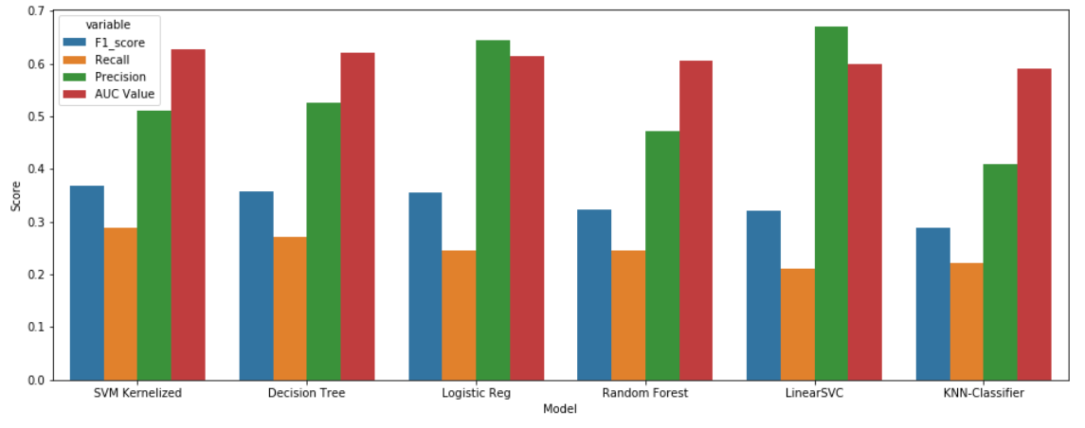
MODELS PERFORMANCE
BUAN 6340.001
Group 1.7
20

Slide 21
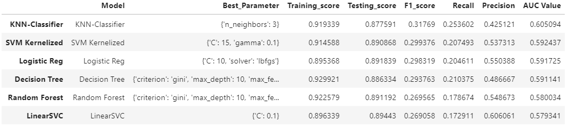
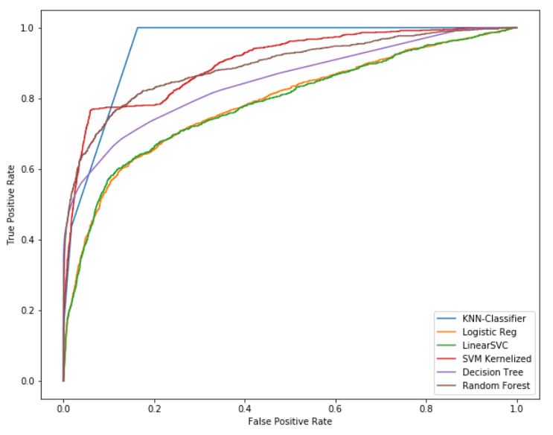
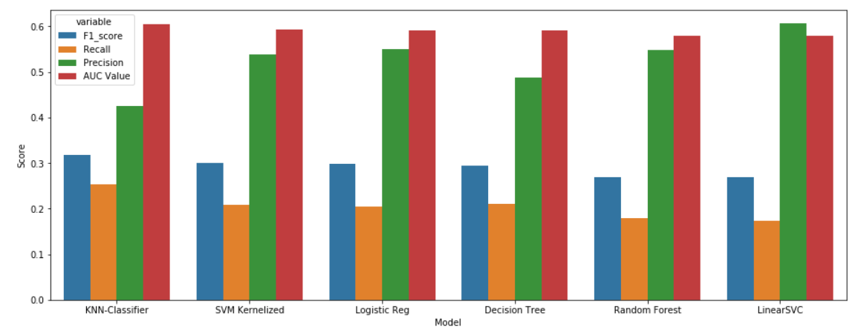
MODELS PERFORMANCE ON REDUCED DATASET
BUAN 6340.001
Group 1.7
19

Slide 22
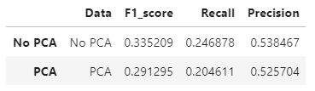
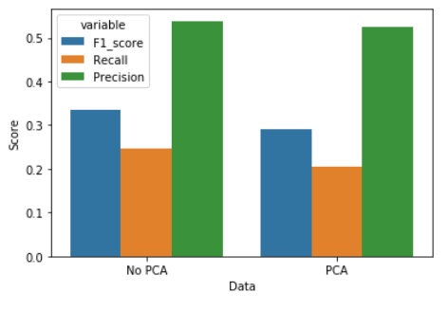
PCA REDUCED DATASET vs ORIGINAL
We ran PCA to find the number of features needed to cover 95% of explained variance.
Original number of features: 53
Reduced number of features: 25
Models on the reduced dataset run faster and efficiently.
BUAN 6340.001
Group 1.7
21

Slide 23
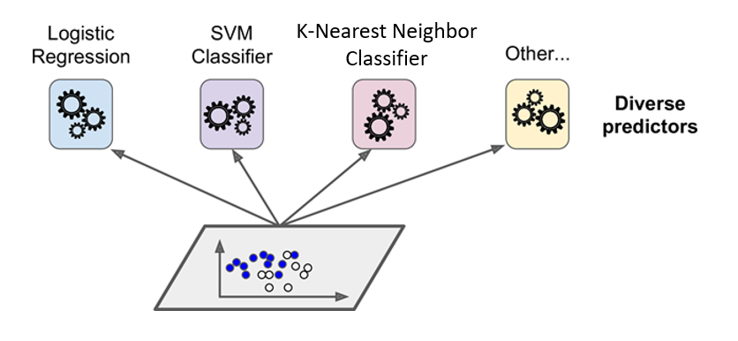
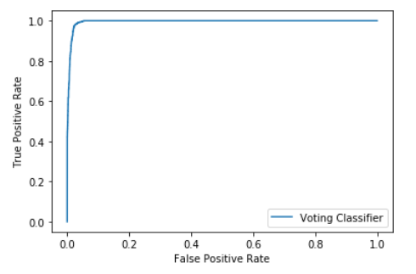

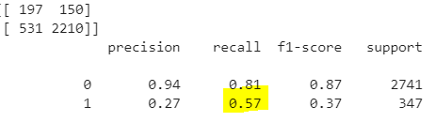
VOTING CLASSIFIER
Models Used
Support Vector Classifier
Random Forest
K Nearest Neighbour
Best Voting = Hard
Confusion Matrix [ 85 262]
[ 83 2658]
Soft Voting ROC
Probability prediction is not available for hard voting.
BUAN 6340.001
Group 1.7
22

Slide 24
FUTURE IMPLEMENTATION PLANS
Boosting Methods
Neural Networks
Bagging Classifiers
Ensemble with a classification model
Automate Model and Parameter Selections
BUAN 6340.001
Group 1.7
22

Slide 25
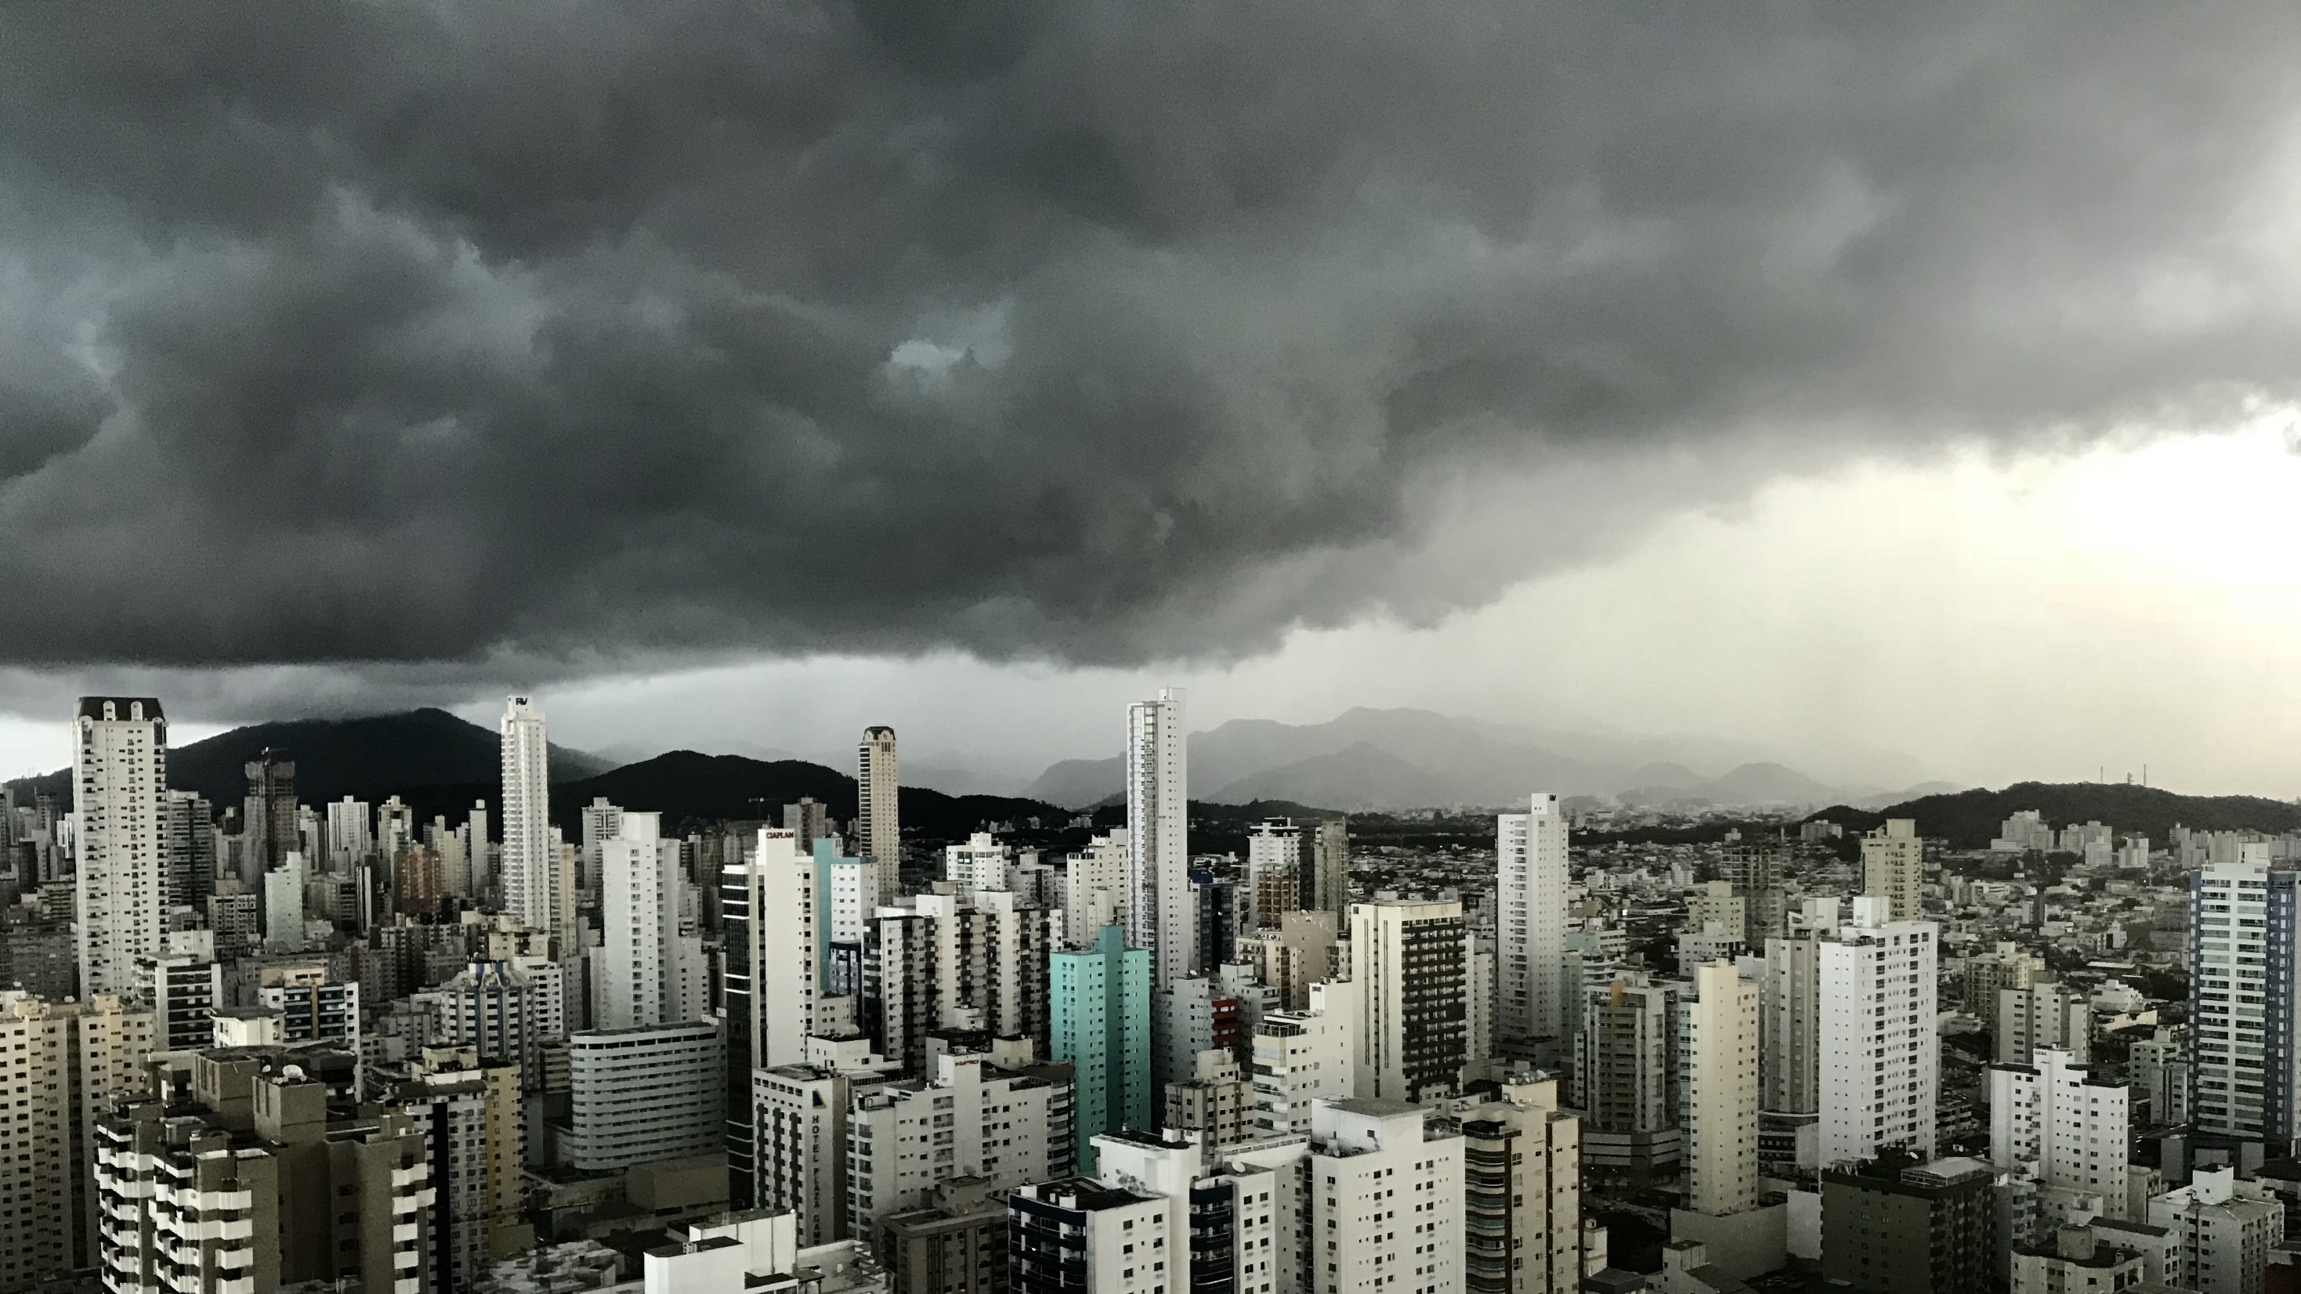
Slide 11
THANK YOU

